Slide 1
MIST7590 Team Meeting November 1, 2017

Slide 2
Site Security Update
Uploaded malicious files
~/wp-content/uploads/2017/10/maink.php
~/wp-content/themes/Minimal/cache/ b12193cc54edf932e43f04db1a287d04.php
~/wp-content/uploads/m0d.php
Changed all website passwords, including Admin1
Deleted suspicious files
Deleted and updated plugins
Will need to update website software

Slide 3
Project Requirements
Maintainable
Ease of Update
Easier way to change text and photos
Easier process to add/remove features
Per Dr. H, we can use CMS tool with 100% UI
Website prototype satisfies code customization rqmt
Mr. Pease approved the following requirements
5.2 Volunteers with user accounts shall be able to log their volunteer date, time, locations, and tasks performed. The app shall allow a representative to log in and confirm these data entered by volunteers
5.4 Total volunteer hours for Hardman Farm shall be tracked also through SGW website. Volunteer Hours table in the database will include the Hardman hours with distinct label. The Hardman Farm manager can then be given access to the site to log in all volunteer hours or the volunteers can log in their Hardman Farm hours at the same site using a selector to distinguish them from their other volunteer hours
Removed validation feature from rqmts/Project Charter

Slide 4
Additional Criteria
Better Site Security
Low to average learning curve
Low Site Hosting Cost
Code is accessible/portable
Mobile support
Search engine functionality
Form plugins & MySQL support
Twitter feed & blog support?

Slide 5
WordPress vs Joomla!
 | PHP / WP | PHP / Joomla!
Free Themes | 3000+ | 1000+
Free Plugins | 44K | 5K
Hosting Cost | Free - $25 | $30 - $80
Frequency of updates | 40 days | 36 days
Security | Target for hackers and prone to attacks; vulnerabilities in CMS from 3rd party plugins | Uses SSL Certificate on web server
Maintenance | Releases updates that may be incompatible with your site | Uses built-in updater
Mobile Support | Responsive site | Supports various mobile devices
Learning curve | Fairly easy to learn with complex documentation | Fairly easy to learn with detailed documentation

Slide 6
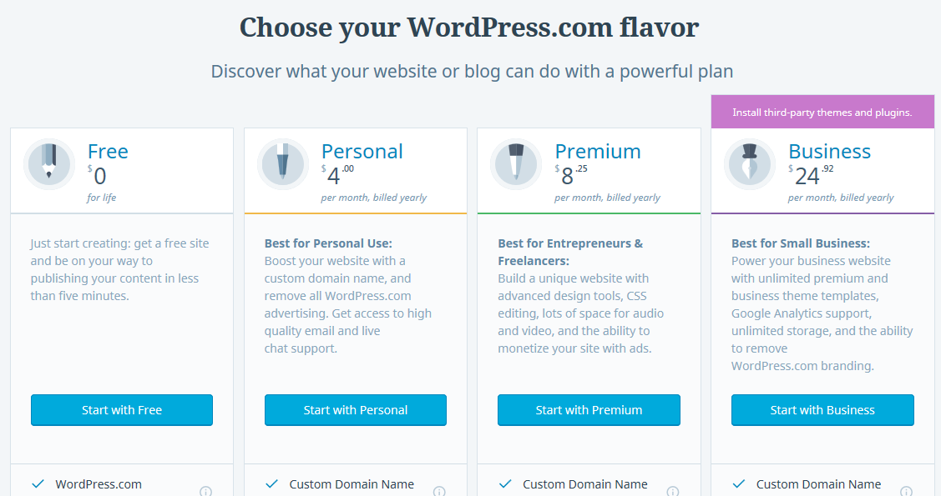
WordPress Site Hosting Price
https://wordpress.com/#plans

Slide 7
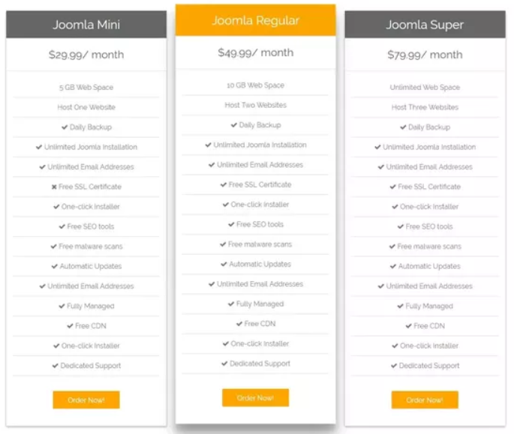
Joomla! Site Hosting Price
https://www.joomla.com/

Slide 8
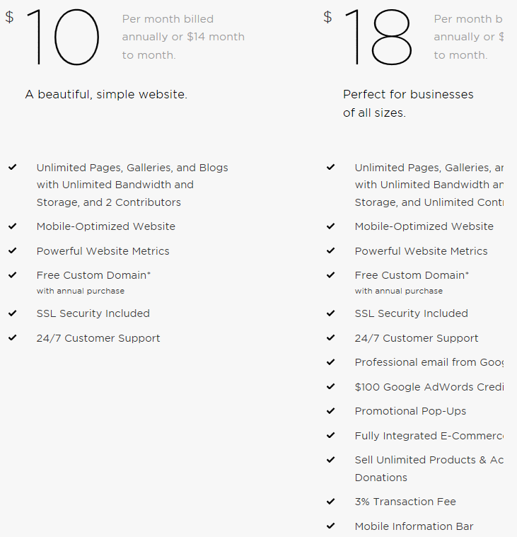
Squarespace CMS & Hosting Price
https://www.squarespace.com/#websites

Slide 9

Site123 CMS & Hosting
https://www.site123.com/faq

Slide 10
BACKUPS

Slide 11
User Stories
As a Friends Chapter Member,
I can easily register as a volunteer
I can log my volunteer hours from my phone
It is easy for me to become a donating “Friend”
I can easily find the park and view upcoming events
As an Administrator,
It is easy for me to add photos to the website
I can input, view, edit, and approve volunteer hours
I can easily publish upcoming events
As a Site Maintainer,
I can easily understand the website and add features
As a Visitor,
I can easily find fun activities for me, my friends and family to do
I can easily find information about renting a cabin

Slide 12
Application Framework/Tool Decision Matrix
Ratings: Exceptional=5, Good=4, Average=3, Below Average=2, Poor=1
 | PHP / WP | PHP / Joomla! | Wix.com | Composite 1 BlueHost | Composite 2 AWS EC2 | Squarespace
Ease of Update | 5 | 5 | 5 | 3 | 3 | 3
Ease of Maintenance | 3 | 4 | 5 | 4 | 4 | 5
Security Strength | 2 | 4 | 5 | 5 | 5 | 5
Easy to Learn | 3 | 3 | 5 | 4 | 3 | 4
Sum | 13 | 16 | 20 | 16 | 15 | 17
Rank | 6 | 3 | 1 | 4 | 5 | 2
NOTES | 100% UI, 50/50 Custom Code access | 100% UI, Code access | 100% UI, No code access | Full Stack, 100% Coding | Full Stack, 100% Coding | 100% UI, No code access

Slide 13
Questions
How much coding are we required to have on our Working System?
What is SGW’s budget for site hosting?
What type of hours should we count from this project for SGW total hours? (team meetings, task assignments, etc.)

